Slide 1
Memphis-Shelby County Schools Real Estate Plan
Effective: 12/04/2024
Board Business Meeting
December 3, 2024

Slide 2
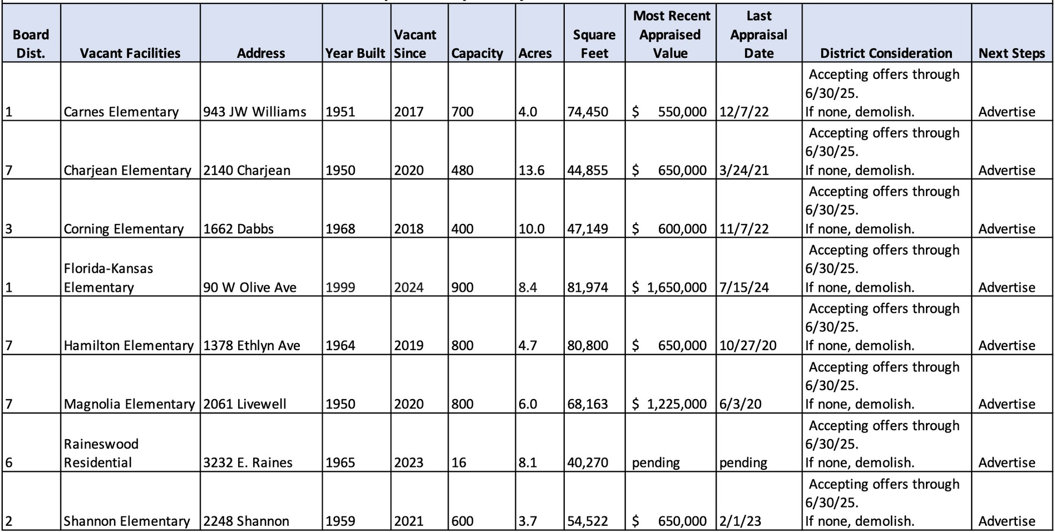
Memphis-Shelby County Schools Vacant Facilities

Slide 3
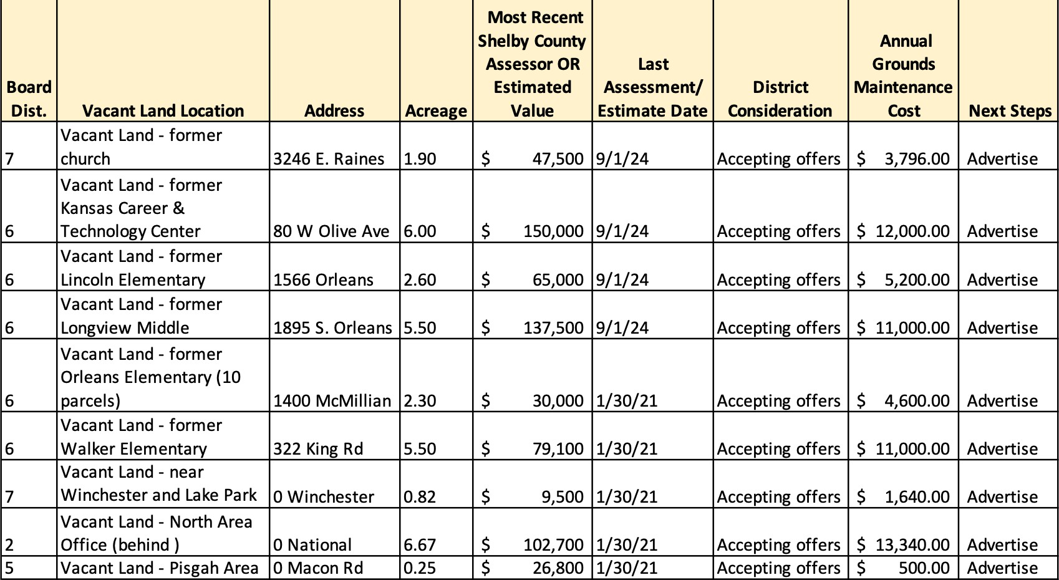
Memphis-Shelby County Schools Vacant Land

Slide 4
Memphis-Shelby County Schools Occupied Facilities

Slide 5
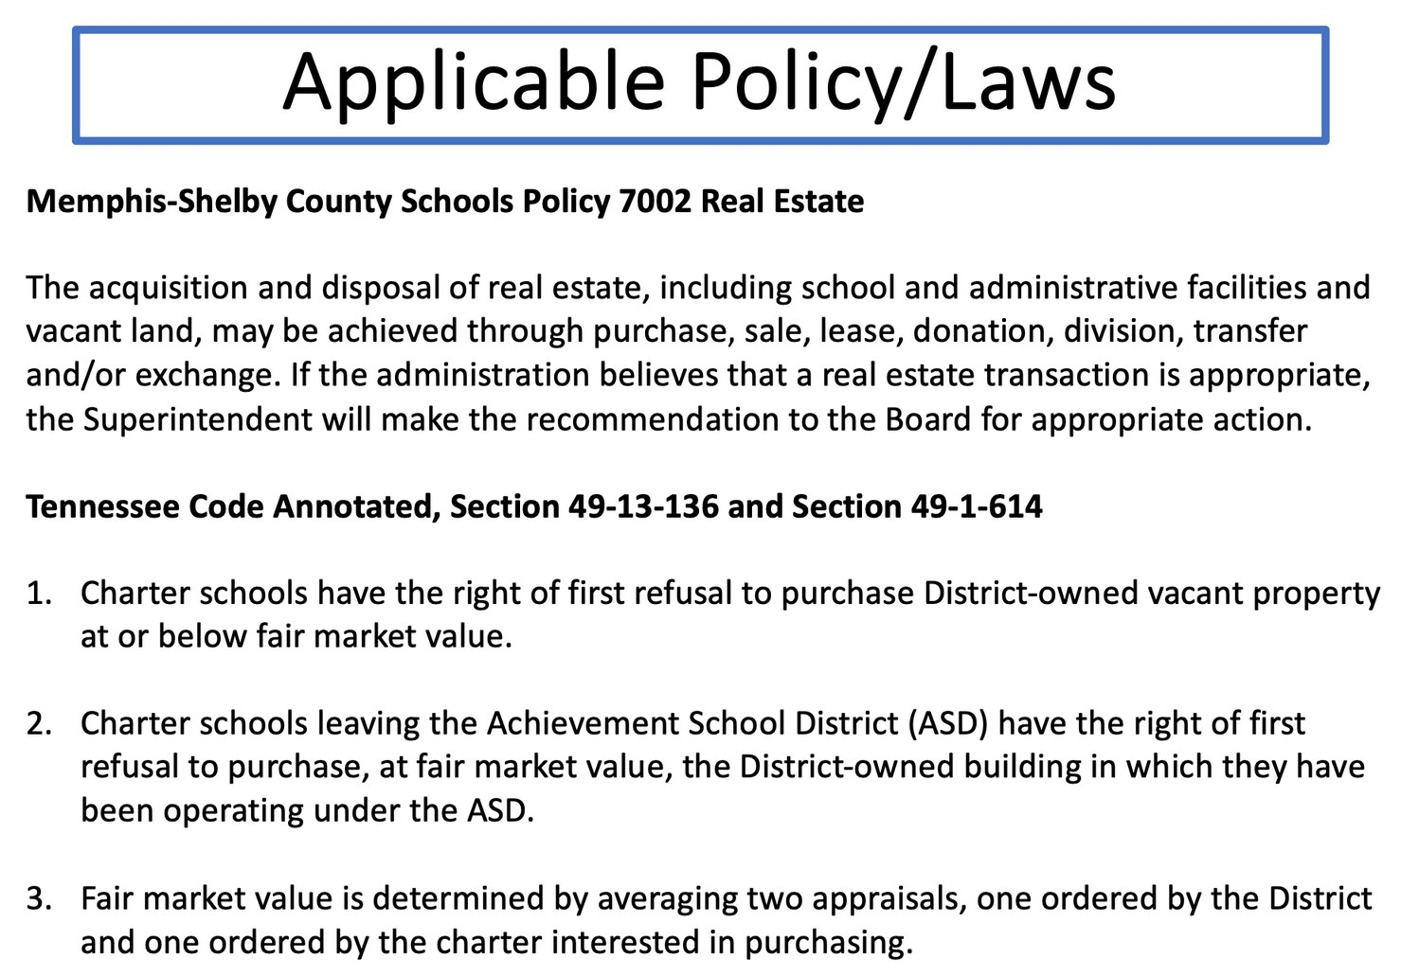

Slide 6
Thank You!

